Slide 1
The Goldwater Scholarship How to craft a competitive application

Slide 2
Program Basics
Eligibility:
Current sophomores or juniors in STEM
US citizens or permanent residents
Plans for Ph.D.
Award benefits:
$7500 toward undergraduate educational expenses
1 or 2 years of scholarship money, depending on when awarded

Slide 3
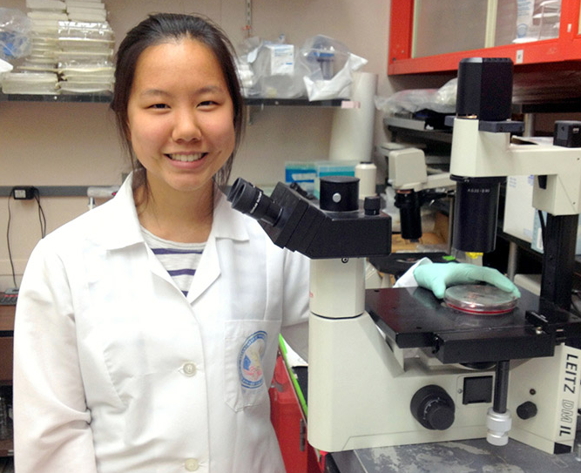
Are YOU a potential Goldwater Scholar?
The ideal candidate exhibits:
Intellectual prowess & ability for leadership in their field
Commitment to a Ph.D. and career in STEM research
A track record of research experiences
A strong academic record*

Slide 4
The Goldwater Scholarship Application
Official transcripts (all colleges/universities attended)
3 letters of recommendation (from scientists)
Complete online application form
3-page research essay

Slide 5
Application components
In descending order of importance:
Letters
Research projects
Research Statement
Career Goals/Professional aspirations
Awards & Honors
What shaped your desire to pursue STEM research
Personal Info

Slide 6
Research Projects
List several key research projects with which you’ve been involved
What was your unique role or contribution?
Do they show progression over time?
Do they show cohesion?
Any informal/side projects?

Slide 7
Research essay
An essay of no more than 3 pages discussing a significant issue or problem in your field of study:
What sort of research topic or problem have you worked on/are currently working on?
What is the next step in your research?
Draft on your own, then get help from your PI
Spell out what is innovative and creative about your work
Use ~5-7 citations, not all from your own lab

Slide 8
Career Goals/Professional Aspirations
What are your professional aspirations?
(summarize in one to two sentences, and then discuss in 3,000 characters)
Indicate which areas of STEM you are considering making your career and specify how your current academic program and your overall educational plans will assist you in achieving this goal.
Hint: What do you hope your BIG contribution will be? (Intellectually/scientifically speaking.) How are you getting there?
Notes:
Think, pair, share

Slide 9
What shaped your desire to pursue STEM research?
Describe an activity or experience that has been important in helping shape or reinforce your desire to pursue a STEM research career
Hints: Did you have an “epiphany” moment? Or has your career inspiration developed over time? How can you put a narrative on it?
Notes:
Think, pair, share

Slide 10
Personal Information
Goldwater Scholars will be representative of the diverse economic, ethnic, and occupational backgrounds of families in the U.S.
Describe any characteristics or other personal information about yourself or your family that you wish to share with the selection committee.
Notes:
Think, pair, share

Slide 11
Parting thoughts:
Campus deadline: December 1st at 12:00pm (noon)
Submit drafts early and often!
Take advantage of ALL resources: writing center, library, Goldwater website, your mentors!
Embrace
the process!

